Slide 1
Chapter 8 Network Models
Math 305 2008

Slide 2
Graph or Network
G = {V, A}
a set of nodes (vertices = V) and
arcs (A) connecting them
arcs can be directed or undirected
arcs can be weighted
Chain between two nodes:
a sequence of arcs such that every arc has exactly one vertex in common with the previous arc
(1,2)-(2,3)-(4,3)
Path between two nodes:
a chain in which the terminal node of each arc is identical to the initial node of next arc
(1,2)-(2,3)-(3,4)
1
4
2
3

Slide 3
8.2 Shortest Path Problem
Find the minimum length path from one node to another
Obvious application: what is the fasted route to Ithaca
Great application in text: when do I trade in a car
we purchase a new car for $12,000 at time 0
cost of maintaining the car during a year depends on its age
nodes: the beginning of a year you own the car
arcs c_{ij}: cost of purchasing a car in i and trading in in j

Slide 4
Car Replacement
Age of Car | Annual Maintenance | Trade-in Price at year end
0 | $2,000 | $7,000
1 | $4,000 | $6,000
2 | $5,000 | $2,000
3 | $9,000 | $1,000
4 | $12,000 | $0
44
31
31
21
21
12
12
1
2
3
4
5
6
7
7
7
7
7
12
12
21

Slide 5
Dijkstra’s Algorithm
Label node 1 (start node) with a permanent 0
Temporarily label each node i that is connected to 1 with the length of the arc joining 1 and i
Choose the node with the smallest label and make it permanent (you need to note the preceding node when you make a label permanent)
If node i has just become the (k+1)^{th} node to be given a permanent label, this is the k^{th} closest node to 1
For each temporary node j that can be reached via i, replace its temporary label by min {j's current temporary label, node i's perm label + distance (i,j)
Make the smallest temporary label permanent
Repeat until you reach the goal node

Slide 6
Track distances to nodes [1 2 3 4 5]
1: [0* ]
2: [0* 7 12 21 31 44 ]
3: [0* 7* 12 21 31 44 ]
Node 2 has just become permanent.
4: Examine paths (1,2) + (2, j) for each j
j temp label (1,2) + (2, j) Change?
3 12 7 + 7 no
4 21 7+12= 19 19
5 31 7+21=28 28
6 44 7+31=38 38
New labels:
[0* 7* 12 19 28 38] Make the smallest one permanent
[0* 7* 12* 19 28 38]

Slide 7
[0* 7* 12* 19 28 38]
Repeat for node 3: examine paths (1,3) + (3, j) for each j
j temp label (1,3) + (3, j) Change?
4 19 12+7= 31 no
5 28 12+12= 24 24
6 38 12+21=33 33
New labels: [0* 7* 12* 19 24 33]
New permanent node 4: [0* 7* 12* 19* 24 33]
Repeat for node 4:
Examine paths (1,4) + (4, j) for each j
j temp label (1,4) + (4, j) Change?
5 24 19+7= 26 no
6 33 19+12=31 31
[0* 7* 12* 19* 24* 31]

Slide 8
Repeat for node 5:
Examine paths (1,5) + (5, j) for each j
j temp label (1,5) + (5, j) Change?
6 31 24+7=31 no, but two paths: (1,5), (5,6) and whatever
got us here.
[0* 7* 12* 19* 24* 31*]
How do we find the path that got us from 1 to 6?
Track where you came from
Or find the node x whose shortest path plus c_{x6} = 31:
node 5: 24 + 7 = 31*
node 4: 19 + 12 = 31*
node 3: 12 + 21 = 33
node 2: 7 + 31 = 38
node 1: 0 + 44 = 44
Paths: 1 → 2 → 4→ 6 or 1 → 3 → 4 → 6 or 1 → 3 → 5 → 6

Slide 9
Condensed Version of the Algorithm
Step 0: identify the node closest to the origin.
Step n: identify the new (unidentified) node closest to each of the n-1 old nodes. Add the distance from origin to the old node to the distance from the old node to the new node.
The minimum of these sums identifies the nth closest node.
Stop when you reach the destination.
Step Node Distance Predecessor
0 1 0 --
1 2 7 1
2 3 12 1
3 4 19 2 or 3
4 5 21 3
5 6 31 4 or 5
Paths: 1 → 2 → 4→ 6 or 1 → 3 → 4 → 6 or 1 → 3 → 5 → 6
44
31
31
21
21
12
12
1
2
3
4
5
6
7
7
7
7
7
12
12
21

Slide 10
8.3 Maximal Flow
Given a network with a capacity assigned to each arc (in both directions),
determine the maximum flow from a source (O) to a sink (T).
Example | Nodes | Arcs | Flow
Airlines | terminals | route | passengers per hour
Oil | storage tanks | pipelines | gallons per hour
Email | server | cable | baud
Hurricane evacuation | city or intersection | roads | cars per hour

Slide 11
Find the max flow from 0 to 6
1
Is this a linear programming problem?
Yes!
Decision variables x_{ij}=flow from i to j
LP:
Maximize x₄₆ + x₅₆
Subject to
0 ≤ x₀₁ ≤ 3 (flow along each branch)
0 ≤ x₁₂ ≤ 2
0 ≤ x₁₃ ≤ 4
...
x₀₁ + x₂₁ + x ₃₁ - x₁₀ + x₁₂ + x₁₃ = 0 (conservation at node 1)
...
Solving with LINGO: omit
Cut: a set of (directed) arcs containing at least one arc from each directed path from source to sink
Max-flow min-cut theorem: For a network from a single source to a single sink, the maximum feasible flow is the minimum cut value for all cuts of the network
4
4
3
1
4
0
2
6
2
1
5
5
4
4
3

Slide 12
8.4 CPM and PERT
PERT: Program Evaluation and Review Technique
CPM: Critical Path Method
Objective of PERT/CPM-type system:
to aid in project planning and control
determine what do you do when
Steps
list activities or events of a project
identify predecessors of each event
develop a network to describe activity precedence, called an AOA (Activity on Arc) network
Arc = activity
Two nodes are connected by at most one activity
Start node (node 1): project ready to begin
Node significance: all activities coming into it have been completed
Finish node: all activities completed

Slide 13
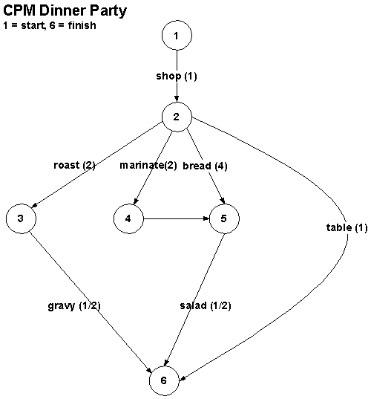
CPM Example
A meal with roast, gravy, salad with artichokes, French bread
Activity | Preceded by | Time
Shop | - | 1
Roast | Shop | 2
Marinate artichokes | Shop | 2
Bread | Shop | 4
Salad | Shop Marinate Bread | .5
Gravy | Shop Roast | .5
Set table | Shop | 1
Note dummy activity from 4 to 5 to ensure 2 nodes are connected by at most 1 arc

Slide 14
CPM
Early event time: (also called earliest time) the time an event will occur if
preceding events are started as early as possible
The event corresponds to a node: all activities leading in are done
Can do this from the graph:
Node Events EET
2 Shop 1
3 Roast 1+2=3
4 Marinate 1+2=3
5 Bread 1+4=5
6 G, S, T max {3+1/2, 5+.5, 1+1} = 5.5
Can also do this from the table =
max {EET for preceder + time for preceder})
Better for large problems or computer solution

Slide 15
Early Event Times
(0)
(1)
(3)
(5)
(3)
(5.5)

Slide 16
CPM
Late event time: the last time at which an event can occur without delaying completion beyond the earliest time.
Start at finish and work backwards:
Find the LET of each successor, subtract the duration of the activity
LET(6) = 5.5
LET(5) = 5.5-1/2 = 5
LET(4) = 5.
LET(3)= 5.5-.5= 5
LET(2)= min LET(3)-3= 2, LET(4)-2=3, LET(5)-4=1, LET(6)-1/5= 5} = 1
LET(1) = LET(2) - 1 = 0
table

Slide 17
Late Event Times
(0, 0)
(1, 1)
(3, 5)
(5, 5)
(3, 5)
(5.5, 5.5)

Slide 18
Total Float (of an activity)
The amount by which starting time can be delayed without delaying completion of the project.
TF(i,j) = LT(j) -ET(i) - t_{ij}
Shop: TF(1, 2) = LT(2) -ET(1) - t_{ij} = 1 - 0 - 1 = 0
Roast: TF(2, 3) = LT(3) - ET(2) - t_{ij} = 5 - 1 - 2 = 2
Marinate: TF(2, 4) = LT(4) - ET(2) - t_{ij} = 5 - 1 - 2 = 2
Bread: TF(2, 5) = LT(5) - ET(2) - t_{ij} = 5 - 1 - 4 = 0
Salad TF(5, 6) = LT(6) - ET(5) - t_{ij} = 5.5 - 5 - .5 = 0
Gravy TF(3, 6) = LT(6) - ET(3) - t_{ij} = 5.5 - 3 - .5 = 2
Set table: TF(2, 6) = LT(6) - ET(2) - t_{ij} = 5.5 - 1 - 1 = 3.5
Critical path; events with total float 0: 1->2->5->6

Slide 19
Free Float
Free float (of an activity): amount by which starting time can be delayed without delaying any other activity beyond its earliest possible starting time.
FF(i,j) = ET(j) -ET(i) - t_{ij}
FF(shop) = ET(2) -ET(1) - t_{ij} = 1 - 0 - 1=0
FF(roast) = ET(3) -ET(2) - t_{ij} = 3 - 1 - 2 = 0
FF(marinate) = ET(4) -ET(2) - t_{ij} =3-1-2=0
FF(bread) = ET(5) -ET(2) - t_{ij} = 5 -1 -4 = 0
FF(salad) = ET(6) -ET(5) - t_{ij} = 5.5 -5 -.5 = 0
FF(gravy) = ET(6) -ET(4) - t_{ij} = 5.5 - 3 - .5 = 2
FF(table) = ET(6) -ET(1) - t_{ij} = 5.5 - 1 - 1 = 3.5

Slide 20
CPM
Activity TF FF
Shop: 0 0
Roast: 2 0*
Marinate: 2 0**
Bread: 0 0
Salad 0 0
Gravy 2 2
Set table: 3.5 3.5
*delay 2 hours without delaying project, but any delay puts off the start of gravy
** funny because the FF delay is of the dummy activity

Slide 21
Using an LP for CPM
xj = time event corresponding
to node j occurs
MIN x6-x1
SUBJECT TO
x2 - x1 >= 1
x3 - x2 >= 2
x4 - x2 >= 2
x5 - x2 >= 4
x5 - x4 >= 0
x6 - x3 >=.5
x6 - x5 >=.5
x6 - x2 >= 1
END
LP OPTIMUM FOUND AT STEP 6
OBJECTIVE FUNCTION VALUE
1) 5.500000
VARIABLE VALUE REDUCED COST
X6 5.500000 0.000000
X1 0.000000 0.000000
X2 1.000000 0.000000
X3 5.000000 0.000000
X4 5.000000 0.000000
X5 5.000000 0.000000
ROW SLACK OR SURPLUS DUAL PRICES
2) 0.000000 -1.000000 (1 2) on critical path
3) 2.000000 0.000000 LET - EET for node 3
4) 2.000000 0.000000
5) 0.000000 -1.000000 (2 5) on critical path
6) 0.000000 0.000000
7) 0.000000 0.000000
8) 0.000000 -1.000000 ( 5 6) on critical path
9) 3.500000 0.000000
SLACK OR SURPLUS give total float
Dual prices = cost of increasing arc duration.
Dual -1 means each hour increase decreases Z by 1,
hence it is on the critical path

Slide 22
Try
Activity | Time | Predecessors
a | 1
b | 2
c | 3 | a
d | 4 | b
1
(0, 0)
a
b
2
(1, 3)
3
(2, 2)
c
d
4
(6, 6)
Arc | TF=LT(j)-ET(i)-t_{ij} | FF= ET(j)-ET(i)-t_{ij}
1-2 | 3-0-1=2 | 1-1=0
1-3 | 2-0-2=0 | 2-0-2=0
2-4 | 6-1-3=2 | 6-2-4=0
3-4 | 6-2-4=0 | 6-2-4=0
Node | EET | LET
1 | 0 | 0
2 | 1 | 5
3 | 3 | 4
4 | 7 | 7

Slide 23
Crashing the Project
By adding resources to an activity, can we speed up the project
Suppose we know the cost of speeding up each activity
and want to finish in 4 hours
Let SH= # hours by which shopping is reduced
MIN
SH+2R+3M+3B+2SA+G+T
SUBJECT TO
SH <=1
R <= 2
M <= 2
B <= 4
SA <= .5
G <= .5
T <= 1
X2 - X1 + SH >= 1
X3 - X2 + R >= 2
X4 - X2 + M >= 2
X5 - X2 + B >= 4
X5 - X4 >= 0
X6 - X3 + G >=.5
X6 - X5 + SA >=.5
X6 - X2 + T >= 1
X6-X1 <=4
END
Activity | #hrs reduced | cost per hr
Shop | SH | 1
Roast | R | 2
Marinate | M | 3
Bread | B | 4
Salad | SA | 5
Gravy | G | 1
Set table | T | 1

Slide 24
Some Probability
Random variable: X
Probability distribution (discrete): the probability
of each value of a random variable occuring
Probability density function (continuous): a function f(x) such that the probability of the value falling within an interval (a,b) is
P(a< X < b) = ∫_{a}^{b} f(x) dx
Expected value ( an "average"): m = ∫ x f(x) dx
Variance (): a measure of how spread out the distribution is
σ² = ∫ (m-x)² f(x) dx
Standard deviation: σ
X | P(X)
Heads | .5
Tails | .5

Slide 25
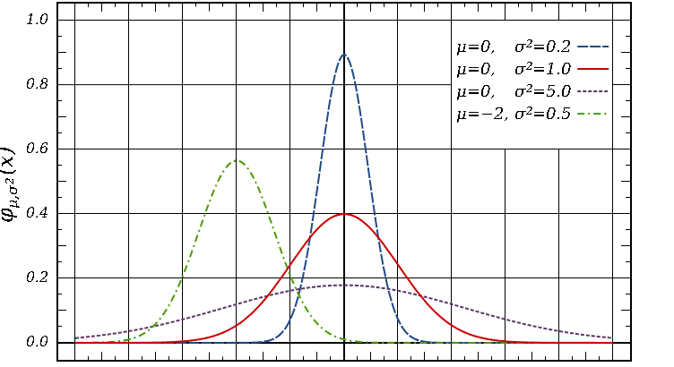
Normal Distribution

Slide 26
Program Evaluation and Review Technique (PERT)
Activity time is random variable with some distribution
Goal: find the probability of completing a project on time
Obtain for each activity:
m = most likely completion time
a = optimistic completion time
b = pessimistic completion time
Assume
completion time is stochastic
distribution is beta
Consequences
E(t) = (a+4m+b)/6 (1/3 weight to midpoint, 2/3 to m)
V(T) = (b-a)²/36

Slide 27
Activities on Dinner Party Critical Path
Assume:
Activity times are statistically independent
Critical path requires more time than any other. Implications:
expected project time = Σ E(T)= 6.5 ^{path}
variance σ² = Σ V(T) = 1.1457
^{path}
standard dev σ = √Σ σ_{e}² = √1.1457 = 1.07
^{path}
3. Project completion time has normal distribution (Central Limit Theorem)
So, if I start at noon and guests arrive at 7, what is the probability I will be ready?
Activity | a | m | b | E(T) | V(T)
shop | .5 | 1 | 5.5 | 1.6667 | 25/36 =.6944
bread | 3 | 4 | 7 | 4.3333 | 4/9 = .4444
salad | .25 | .5 | .75 | .5 | 1/144 =.0069
SUM |  |  |  | 6.5 | 1.1457

Slide 28
Two ways to Calculate the Probability
How many standard deviations is 7 from 6.5?
1 sd = 1.07
.5/1.07= .46728
P(done before 7) = 1 - area past 7
Using standard normal tables
Area between 0 and .46728 sd = .1808
P(done before 7) = .5+ .1808 = .6808
Using Excel
NORMALSDIST(. 46728) = .6798 (cumulative normal distribution)
NORMDIST(7, 6.5,1.07,true) = .6798
Difficulties
assuming activities have independent durations
assuming that the distribution is beta
CPM critical path is always the critical path of a nondeterministic project

Slide 29
8.6 Minimal Spanning Tree
Assume a network with n nodes
Spanning tree: a group of n-1 arcs that connects all of the network and contains no loops
MST: the sum of the paths are minimal
Examples:
network the campus
shovel snow in the winter
Algorithm
pick any node i and connect it to the nearest neighbor, j. The connected nodes C ={i,j}
pick the node closest to a connected node and add it to C.
continue until all nodes are in C

Slide 30
1
1
2
2
2
6
5
4
2
3
4
4
3
5
How would you write a program to do this?

Slide 31
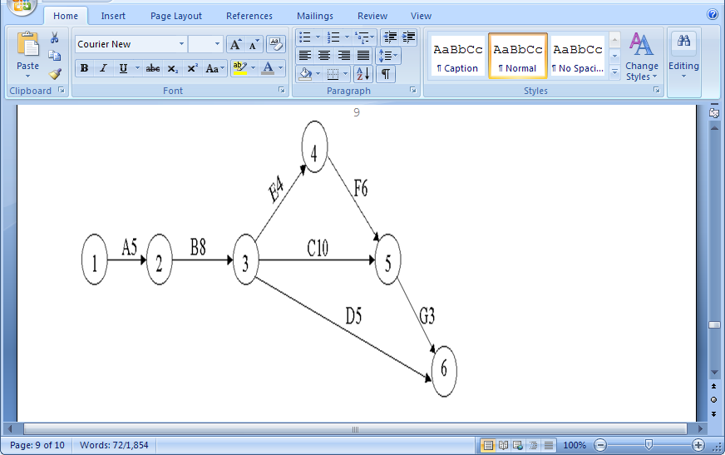
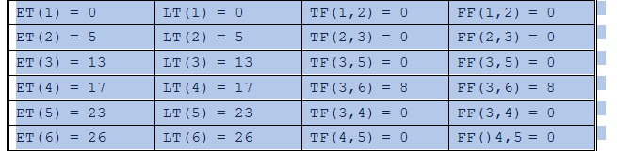
Problem8.4 5a
Act. | Pred. | Dur.
A | - | 5
B | A | 8
C | B | 10
D | B | 5
E | B | 4
F | E | 6
G | C, F | 3

